Slide 1
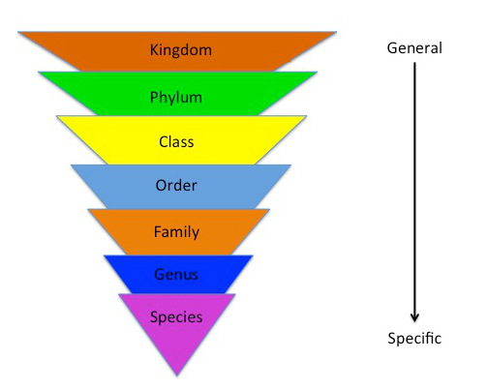
Fill in the missing terms:
1.
2.
3.
4.
5.
6.
7.

Slide 2
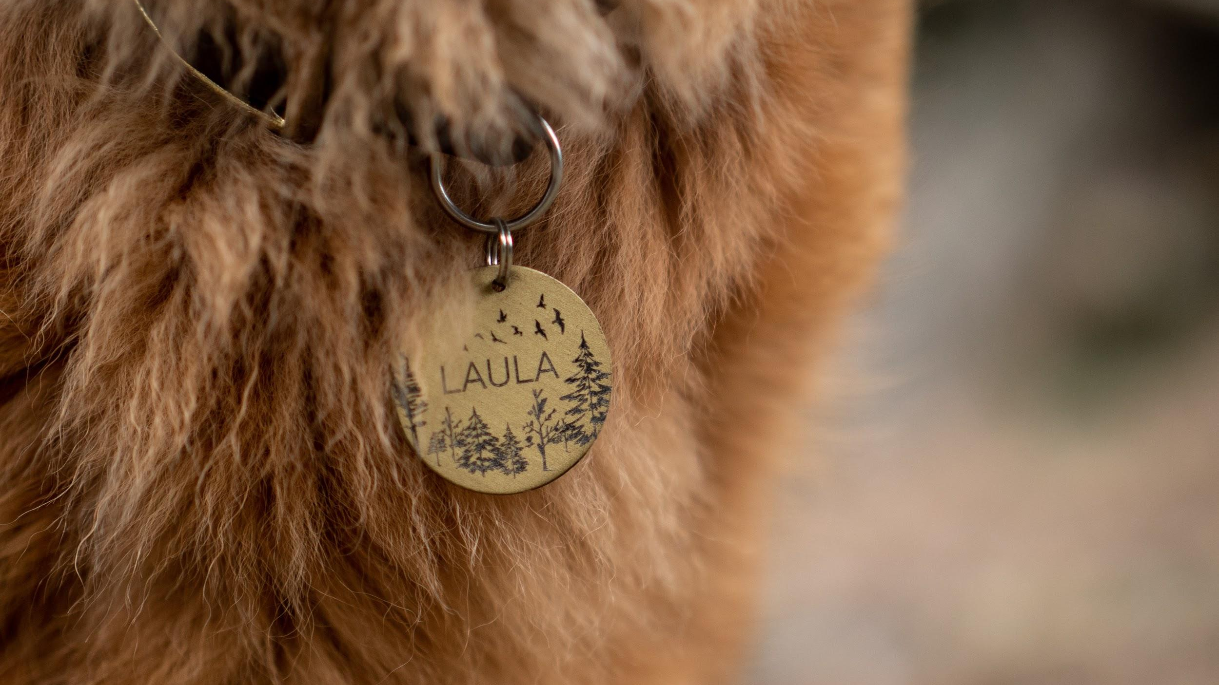
NAMING CONVENTIONS
We will name organisms using scientific conventions.
Notes:
Insert cover image and use transparency settings to fade image.

Slide 3
Do not delete this slide.
This slide is designed so that you can copy the prompt box you need and insert it into your slides.
This slide is hidden and will not be included when presenting your lesson.
TRACK WITH ME
VOCABULARY
1 -
HINT
Students, remember….
CHECK FOR UNDERSTANDING
READ WITH ME
TEACHER CUE
MAKE THE CONNECTION
Students, you already know….
EXTENSION
GESTURE WITH ME

Slide 4
Fill in the missing terms:

Slide 5
Repeat the opposite word/phrase.
CLASSIFICATION
SORTING BY CHARACTERISTICS

Slide 6
Repeat the opposite word/phrase.
OBSERVABLE FEATURE
FEATURE YOU CAN SEE

Slide 7
Repeat the opposite word/phrase.
VERTEBRATE
HAS A BACKBONE

Slide 8
Repeat the opposite word/phrase.
INVERTEBRATE
NO BACKBONE

Slide 9
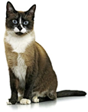
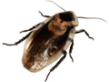
True or false:
A cockroach is a vertebrate
A cat is a mammal
A cat has an exoskeleton
A cockroach has antennae
cat
cockroach

Slide 10
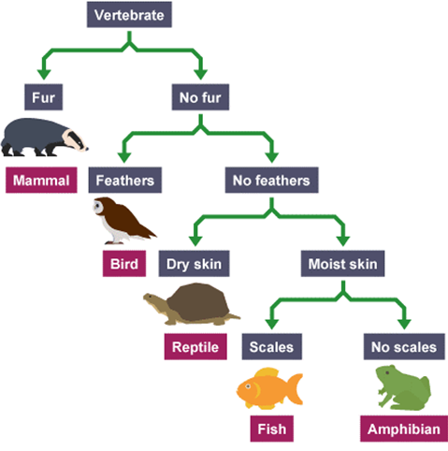
What is one difference between a fish and an amphibian?

Slide 11
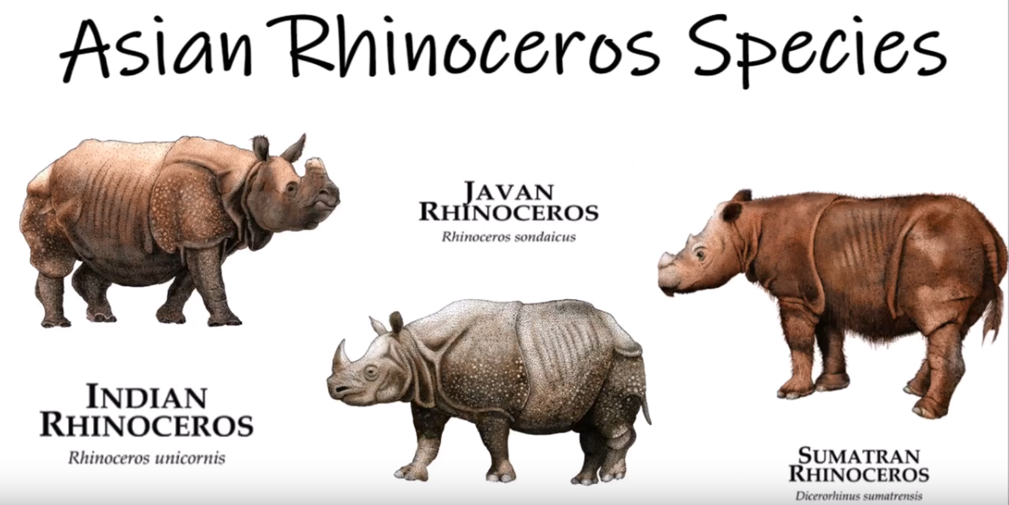
Why do we classify animals?

Slide 12

We will use the Linnaean classification system to compare organisms.
Organise these organisms from most closely to least closely related to humans.
Example | Human | Bottlenose Dolphin | Bobtail Lizard | Chimpanzee | Sponge
Kingdom | Animalia | Animalia | Animalia | Animalia | Animalia
Phylum | Chordata | Chordata | Chordata | Chordata | Porifera
Class | Mammalia | Mammalia | Reptilia | Mammalia | Demospongiae
Order | Primates | Artiodactyla | Squamata | Primates | Haplosclerida
Family | Hominidae | Delphinidae | Scincidae | Hominidae | Niphatidae
Genus | Homo | Tursiops | Tiliqua | Pan | Amphimedon
Species | Homo sapiens | Tursiops osennae | Tiliqua rugosa | Pan troglodytes | Amphimedon queenslandica
Notes:
Please include tasks/questions here rather than just referring to a worksheet. This will save on photocopying and facilitate sharing with other schools.
Try and build tasks/questions which escalate through Bloom’s Taxonomy. This will help with differentiation.

Slide 13
We will name organisms using scientific conventions.
TRACK WITH ME
READ WITH ME
We will use genus and species levels of classification to name organisms.
We will name organisms based on their Linnaean classification.
DECLARE THE OBJECTIVE
Read the learning objective to your partner.
Notes:
Learning Objectives contain concepts (nouns, big ideas), skills (verbs, measurable behaviours) and sometimes context (restricting or targeting conditions).
●Example: Students will be able to describe the concept of density and apply it to floating and sinking.
●
Success criteria are specific measurable outcomes that if met mean that the student has met the learning objective.
Examples:
•Students will be able to compare densities of substances using mass and volume.
•Students will be able to identify whether a solid or liquid will float or sink in a liquid based on their densities.

Slide 14
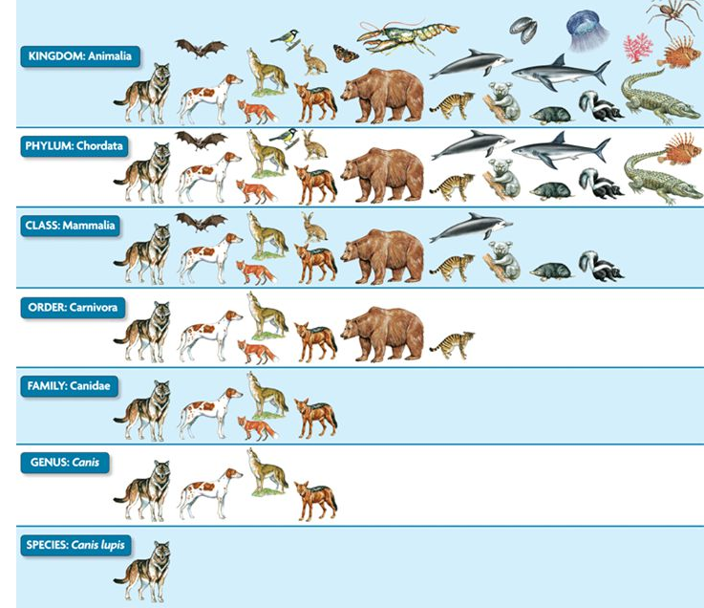
We will name organisms using scientific conventions.
MAKE THE CONNECTION
Students, you already know…. Animals are classified using the Linnaeus system. Carl Linnaeus also developed a hierarchical naming structure that gave information about how an organism is named. Organisms that have more classification levels in common are more closely related.
What level has the most animals in it?
Level | Grizzly Bear | Wolf | Coyote
Kingdom | Animalia | Animalia | Animalia
Phylum | Chordata | Chordata | Chordata
Class | Mammalia | Mammalia | Mammalia
Order | Carnivora | Carnivora | Carnivora
Family | Ursidae | Canidae | Canidae
Genus | Ursus | Canis | Canis
Species | Ursus arctos | Canis lupis | Canis latrans

Slide 15
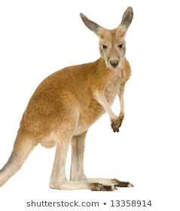
We will name organisms using scientific conventions.
CHECK FOR UNDERSTANDING
Why is it important for organisms to have a scientific name as well as a common name?
Every animal has a common name. This is the name you use in your own language.
Organisms’ have different names in different languages so it can be difficult for scientists to use common names to classify organisms. Some organisms also have more than one common name.
Organisms’ scientific names are universal₁ names used by scientists. Scientific names are written in Latin and used by everyone, no matter what language is spoken.
Macropus rufus
EXTENSION
We say kangaroo as a common name but there are 5 different species so they need 5 different scientific names.
English Common name | Spanish Common name | Scientific name in Latin
House Cat | casa de gato | Felis catus
Red Kangaroo | canguro rojo | Macropus rufus
VOCABULARY
1 - worldwide or everyone.

Slide 16
We will name organisms using scientific conventions.
CHECK FOR UNDERSTANDING
Why does a scientific name only need to include genus and species?
A scientific name is written in two parts. This is known as binomial₁ nomenclature₂.
Part one: genus name
Part two: species name
Every individual species has its own scientific name. There are 8.7 million species all with their own scientific name using genus and species.
The Kingdom to Family aren’t used in naming to keep it simple.
Common name: House cat
Scientific name: Felis catus
Animalia-- Chordata -- Mammalia-- Carnivora-- Felidae-- Felis-- catus
Common name: dog
Scientific name: Canis familiarus
Animalia-- Chordata -- Mammalia-- Carnivora-- Canidae -- Canis -- familiarus
VOCABULARY
1- two name. 2 - naming system.

Slide 17
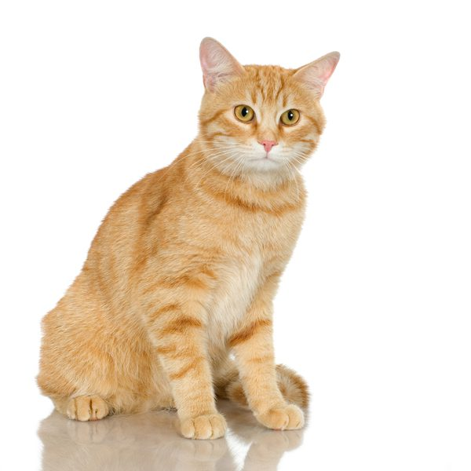

We will name organisms using scientific conventions.
CHECK FOR UNDERSTANDING
Is this scientific name written correctly: Felis Catus
There are specific conventions₁ when writing a scientific name.
Step 1. Write the genus name first, the first letter must be a capital letter. Felis
Step 2. Write the species name second, all letters must be lowercase. catus
Step 3. When typing on a computer use italics for the genus and species.
When writing on paper underline the genus and species.
House cat
Felis catus
VOCABULARY
1- a way of doing something.

Slide 18
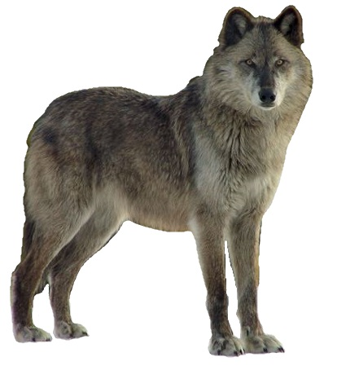
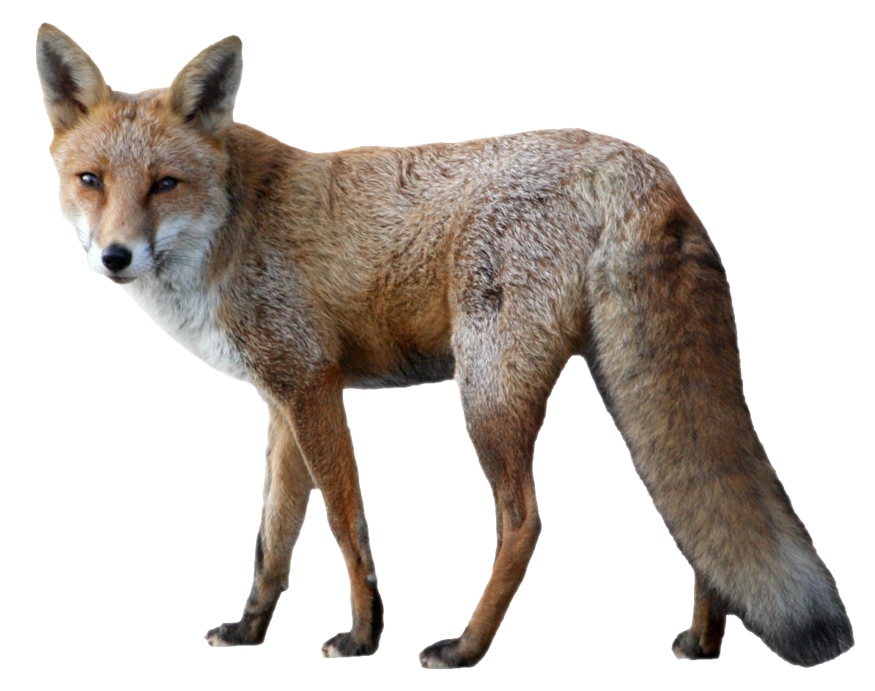
We will name organisms using scientific conventions.
CHECK FOR UNDERSTANDING
Why is one scientific name italicised and one is underlined?
There are specific conventions₁ when writing a scientific name.
Part one: genus name
Part two: species name
Step 1. Write the genus name first, the first letter must be a capital letter.
Step 2. Write the species name second, all letters must be lowercase.
Step 3. When typing on a computer use italics for the genus and species. When writing on paper underline the genus and species.
Canis lupis
Example | Grizzly Bear | Wolf | Coyote
Part one: Genus | Ursus | Canis | Canis
Part two: Species | arctos | lupis | latrans
Scientific name Typing: Writing: | Ursus arctos Ursus arctos | Canis lupis Canis lupis | Canis latrans Canis latrans
Canis latrans

Slide 19
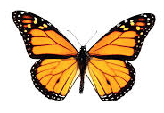
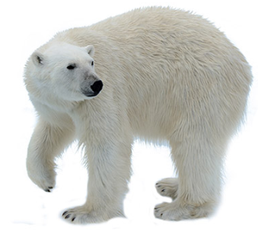
We will name organisms using scientific conventions.
CHECK FOR UNDERSTANDING
What is included in a scientific name?
Write the scientific name for the two examples below.
Use the correct conventions for naming.
Common name: Polar Bear
Kingdom: Animalia
Phylum: Chordata
Class: Mammalia
Order: Carnivora
Family: Ursidae
Genus: Ursus
Species: maritimus
Common name: Monarch Butterfly
Kingdom: Animalia
Phylum: Arthropoda
Class: Insecta
Order: Lepidoptera
Family: Nymphalidae
Genus: Danaus
Species: plexippus
HINT
Students, remember…. Part one: genus name Part two: species name Step 1. Write the genus name first, the first letter must be a capital letter. Step 2. Write the species name second, all letters must be lowercase. Step 3. When typing on a computer use italics for the genus and species. When writing on paper underline the genus and species.

Slide 20
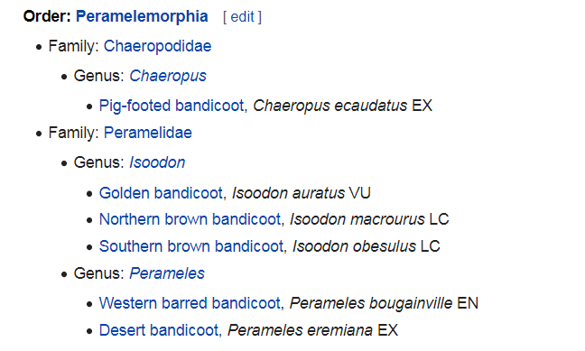
We will name organisms using scientific conventions.
All organisms need a scientific name. In Australia there are over 100 types of mammals called marsupials. There are six types of bandicoots alone. Each one of them has a specific scientific name.
CHECK FOR UNDERSTANDING
Why does each bandicoot need its own scientific name?

Slide 21
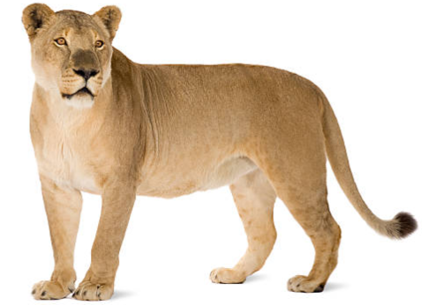
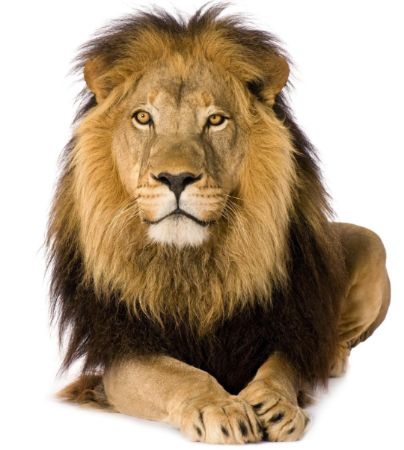
We will name organisms using scientific conventions.
CHECK FOR UNDERSTANDING
Is this an example of a correct scientific name? Felidae Panthera Explain your answer.
Organisms’ scientific names are universal₁ names used by scientists. Scientific names are written in Latin and used by everyone, no matter what language is spoken.
A scientific name is written in two parts. This is known as binomial₁ nomenclature₂.
Part one: genus name
Part two: species name
Step 1. Write the genus name first, the first letter must be a capital letter.
Step 2. Write the species name second, all letters must be lowercase.
Step 3. When typing on a computer use italics for the genus and species.
When writing on paper underline the genus and species.
Common name: Lion
Kingdom: Animalia
Phylum: Chordata
Class: Mammalia
Order: Carnivora
Family: Felidae
Genus: Panthera
Species: leo

Slide 22
We will name organisms using scientific conventions.
Write the scientific name for the three examples below.
Use the correct conventions for naming.
Research an invertebrate animal and fill in the table below:
HINT
Students, remember…. Part one: genus name Part two: species name Step 1. Write the genus name first, the first letter must be a capital letter. Step 2. Write the species name second, all letters must be lowercase. Step 3. When typing on a computer use italics for the genus and species. When writing on paper underline the genus and species.
Example | Lion | Tiger | Cat
Kingdom | Animalia | Animalia | Animalia
Phylum | Chordata | Chordata | Chordata
Class | Mammalia | Mammalia | Mammalia
Order | Carnivora | Carnivora | Carnivora
Family | Felidae | Felidae | Felidae
Genus | Panthera | Panthera | Felis
Species | leo | tigris | catus
Scientific name:
Notes:
Please include tasks/questions here rather than just referring to a worksheet. This will save on photocopying and facilitate sharing with other schools.
Try and build tasks/questions which escalate through Bloom’s Taxonomy. This will help with differentiation.

Slide 23
We will name organisms using scientific conventions.
We will use genus and species levels of classification to name organisms.
We will name organisms based on their Linnaean classification.
CHECK FOR UNDERSTANDING
Check Success Criteria.

